Slide 1
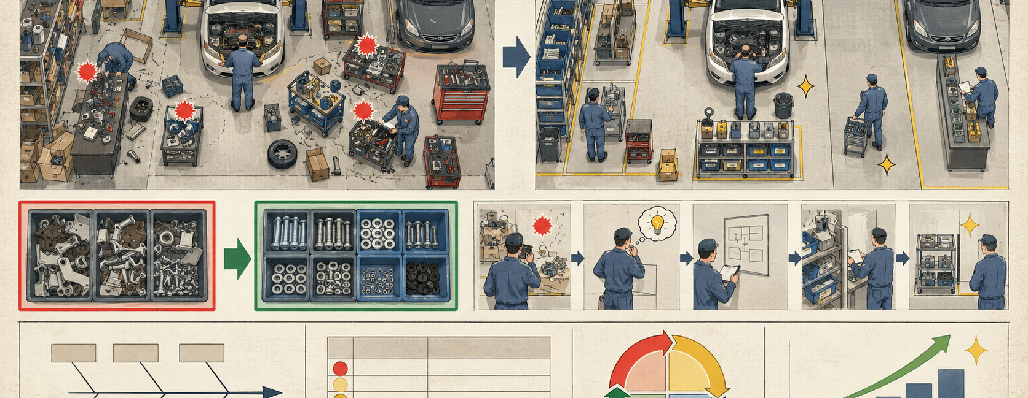
A3: UMI PARTS GROWTH PROBLEM
Current state → gap → cause → countermeasure → owner.
ISZE / UMI Sales Review Prototype
source: UMI Sales Review FY2027
Notes:
[Sources]
- Source deck: ISZE_UMI_Sales_Review_FY2027_ModeA_only.pptx. UMI review title and meeting context: lines 23-25.
- FY2027 YTD and budget/LY figures: lines 55-65.
- Commercial parts performance: lines 70-80.
- Category movers: lines 85-150.
- GPS, service-parts coverage, IDS and fleet/target data: lines 176-235 and 240-276.
- SPA and Sales-to-Dealer ask: lines 286-345.

Slide 2
Current state and gap
A3 style keeps the customer focused on one factual problem at a time.
Current state
Gap
Capture
Dealer standard
€875k YTD
-14% vs LY
54.2% GPS
60.9%
+2% vs budget
July -38% YoY
potential €4.636m
below 74.8% network
ISZE / UMI Sales Review Prototype
source: UMI Sales Review FY2027
Notes:
[Sources]
- Source deck: ISZE_UMI_Sales_Review_FY2027_ModeA_only.pptx. UMI review title and meeting context: lines 23-25.
- FY2027 YTD and budget/LY figures: lines 55-65.
- Commercial parts performance: lines 70-80.
- Category movers: lines 85-150.
- GPS, service-parts coverage, IDS and fleet/target data: lines 176-235 and 240-276.
- SPA and Sales-to-Dealer ask: lines 286-345.

Slide 3

Root cause hypothesis
Separate market demand from stock timing and local sourcing.
Cause 1
Cause 2
Availability / stock timing
Pricing vs local alternatives
validate with UMI
validate with UMI
Cause 3
Cause 4
Dealer process and IDS spread
Missing Sales-to-Dealer data
validate with UMI
prevents factual SPA targeting
ISZE / UMI Sales Review Prototype
source: UMI Sales Review FY2027
Notes:
[Sources]
- Source deck: ISZE_UMI_Sales_Review_FY2027_ModeA_only.pptx. UMI review title and meeting context: lines 23-25.
- FY2027 YTD and budget/LY figures: lines 55-65.
- Commercial parts performance: lines 70-80.
- Category movers: lines 85-150.
- GPS, service-parts coverage, IDS and fleet/target data: lines 176-235 and 240-276.
- SPA and Sales-to-Dealer ask: lines 286-345.

Slide 4
Countermeasure plan
Each countermeasure has a visible output and owner.
Shell
Close price position
Restart orders
Service parts
Pilot rotor/filter pack
GPS lift
SPA
Counter-list agreed
Commercial push
Data
Monthly PN feed
Stock vs lost-job clarity
ISZE / UMI Sales Review Prototype
source: UMI Sales Review FY2027
Notes:
[Sources]
- Source deck: ISZE_UMI_Sales_Review_FY2027_ModeA_only.pptx. UMI review title and meeting context: lines 23-25.
- FY2027 YTD and budget/LY figures: lines 55-65.
- Commercial parts performance: lines 70-80.
- Category movers: lines 85-150.
- GPS, service-parts coverage, IDS and fleet/target data: lines 176-235 and 240-276.
- SPA and Sales-to-Dealer ask: lines 286-345.

